Slide 1
电池生命周期管理系统（计科方向） Advanced Deep Learning Framework for Enhanced Estimation of Lithium-Ion Batteries' Remaining Useful Lifetime Integrating Electrochemical Impedance Spectroscopy Data Analysis
Comprehensive Design
Nov 25，2023
计算机科学与技术 - 王浩羽
指导老师：宋轩

Slide 2

Outline
Background and Significance
Relative Work
Data Exploration
Objectives
Milestones
Reference
Q&A

Slide 3
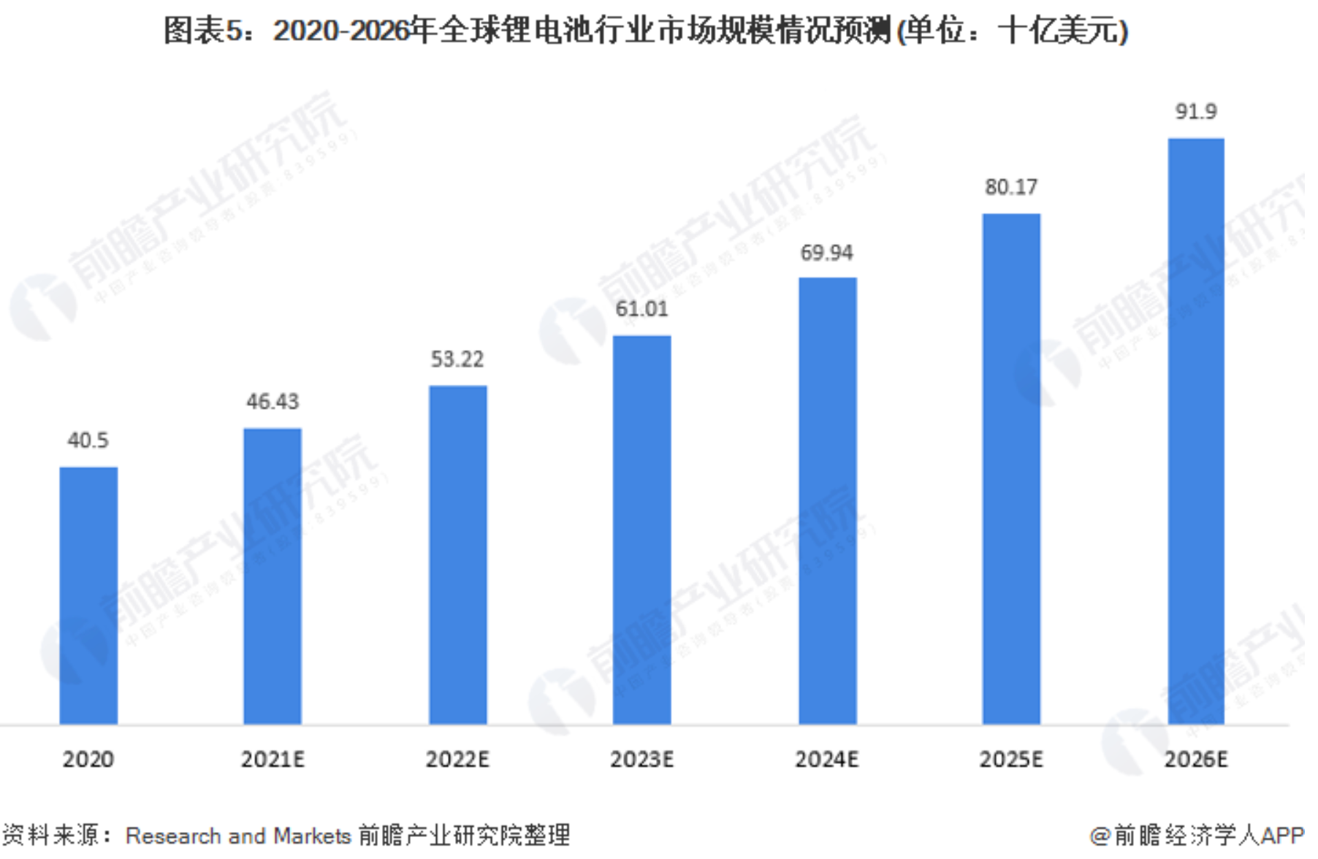
Background and Significance
预计新能源汽车销量占比:2025年20%，2030年40%
全球电动车锂离子电池消耗量年增长率26%
《新能源汽车产业发展规划2021-2035》

Slide 4
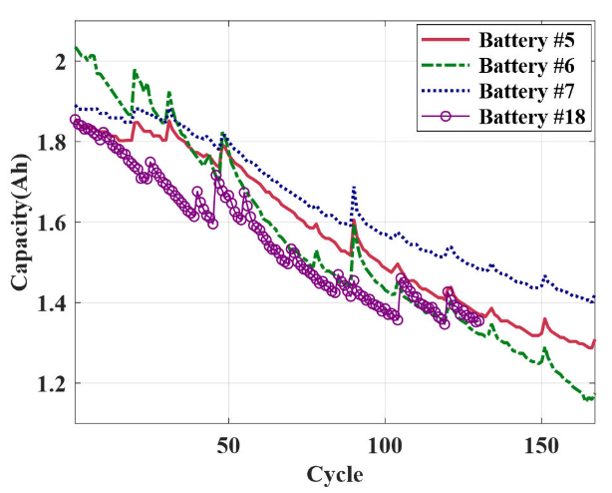
Background and Significance
Aging phenomenon：
The performance of Li-ion batteries will decrease with time (calendar aging) and use (cycle aging)
Influence：
increase operating costs
reduce the service life of the equipment
affect the safe operation of the equipment
Research:
Depending on a mass of historical data
Lifetime is different according to different use scenarios and production process
Image source: Park, K., Choi, Y., Choi, W. J., Ryu, H.-Y., & Kim, H. (2020). LSTM-Based Battery Remaining Useful Life Prediction With Multi-Channel Charging Profiles. IEEE Access, 8, 20786–20798.

Slide 5

Background and Significance
Assess
The current health of electric vehicles
working environment
Estimate
History Data
Usage habits
The remaining Useful Lifetime (RUL)

Slide 6
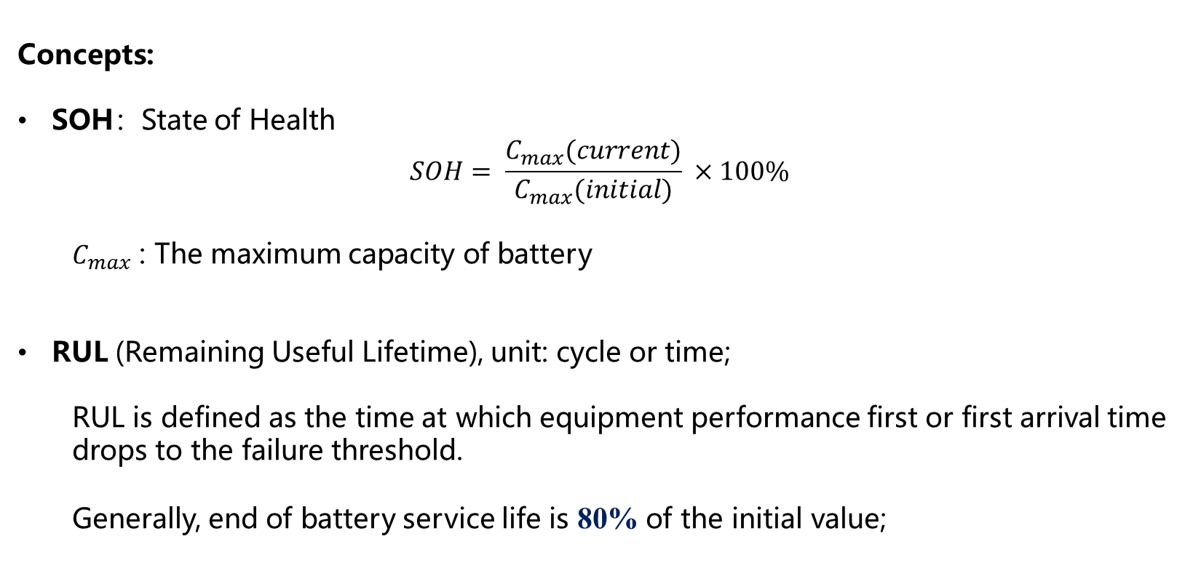
Relative Work - Concepts
Concepts:
SOH：State of Health
$$SOH= \frac{C_{max}(current)}{C_{max}(initial)} ×100\%$$
$C_{max}$ : The maximum capacity of battery
RUL (Remaining Useful Lifetime), unit: cycle or time;
RUL is defined as the time at which equipment performance first or first arrival time drops to the failure threshold.
Generally, end of battery service life is 80% of the initial value;

Slide 7
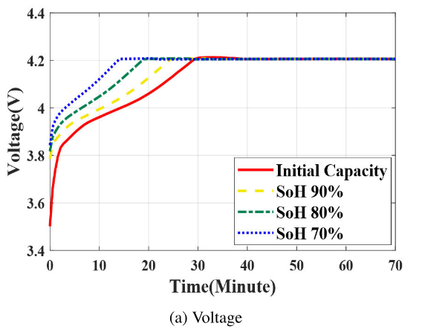
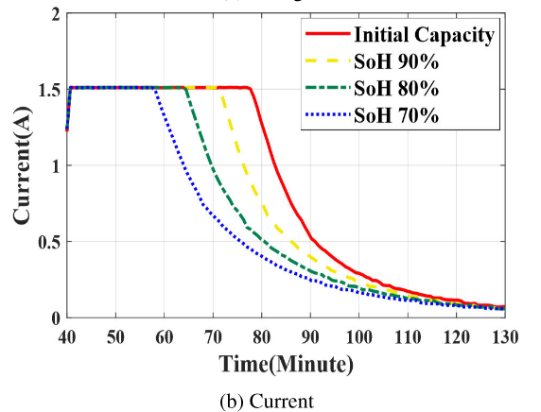
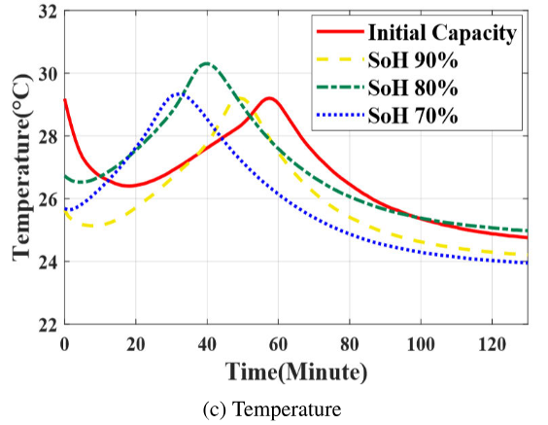
Relative Work - Concepts
Features:
Charge Cycle 充放电周期
Charging Curve / Discharging Curve of Voltage, Current and Temperature
Image source: Park, K., Choi, Y., Choi, W. J., Ryu, H.-Y., & Kim, H. (2020). LSTM-Based Battery Remaining Useful Life Prediction With Multi-Channel Charging Profiles. IEEE Access, 8, 20786–20798.
Notes:
比亚迪通过完全放电然后充电的方式, 来计算电池当前最大容量; 完全的充放电往往对电池伤害较大, 所耗时间也比较长. 我们希望能够利用充电曲线的一个较小的窗口来对SOH进行预测

Slide 8
Relative Work
RUL prediction with charging curve of time series
Model-based techniques
Data-driven-based techniques
Hybrid-based techniques
SOH prediction with charging curve of specific charge cycle
RUL / SOH prediction with EIS

Slide 9
Relative Work - RUL prediction
Mathematics
Experimental results
Empirical data
complexity and computational cost
Model-based techniques
Physics-based model
Equivalent circuit model
Empirical model
Data-driven-based techniques
Machine Learning
Adaptive filtering 自适应过滤
Random process 随机过程
Hybrid-based techniques
Simple and Effective

Slide 10
Relative Work – Machine Learning
Machine Learning Model
for RUL prediction and SOH prediction
 | RUL | SOH
input | A series of charging curve | A single charging curve
output | A series of RUL Or a single RUL | A single SOH
model | RNN, LSTM, CNN, DNN, … | ANN, DNN, …
complexity and cost | Higher and more | Lower and less
Notes:
RNN效果相对于LSTM较差，CNN直接使用图像处理；可以看到LSTM和CNN的复杂度都比较高，计算速度较慢。

Slide 11
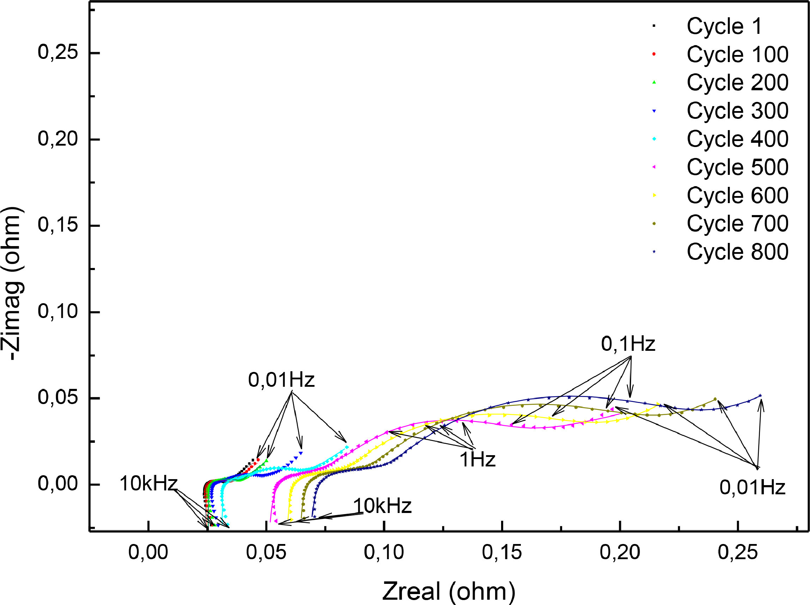

Relative Work – EIS
EIS (Electrochemical Impedance Spectroscopy) 电化学阻抗谱
Features:
$R_{ohm}$ : Ohm Resistance 欧姆阻抗
$R_{SEI}$ : Solid Electrolyte Interface Resistance 固体电解质界面阻抗
$R_{ct}$ : Charge Transfer Resistance 电荷传递阻抗
Image source: Ph.D..Jiahao Xu
Notes:
电化学阻抗谱 (EIS) 通过测量电流对电压扰动的响应来获取宽频率范围内的阻抗，已知包含所有材料的丰富信息性质、界面现象和电化学反应

Slide 12
Relative Work – EIS
EIS
real-time, non-invasive
information-rich: materials properties, interfacial phenomena and electrochemical reactions.
hitherto underused in battery diagnosis

Slide 13
Data Exploration
Capacity data:
25℃ => 8 batteries; 35℃ and 45℃ => 2 batteries
200 – 350 cycles
For each cycle, Voltage, Current and Capacity with time are provided
EIS data:
200 – 350 cycles
For each cycle, frequency, Re(Z), Im(Z) with time are provided
Dataset resource: https:// doi.org/10.5281/zenodo.3633835.
Ref. Zhang, Y., Tang, Q., Zhang, Y., Wang, J., Stimming, U., & Lee, A. A. (2020). Identifying degradation patterns of lithium ion batteries from impedance spectroscopy using machine learning. Nature Communications, 11(1). https://doi.org/10.1038/s41467-020-15235-7

Slide 14
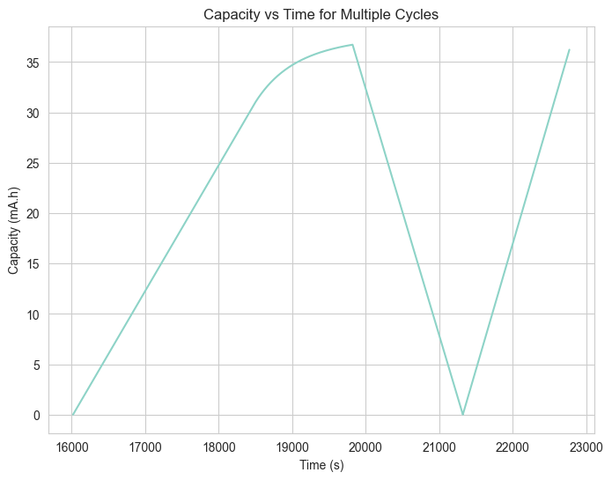
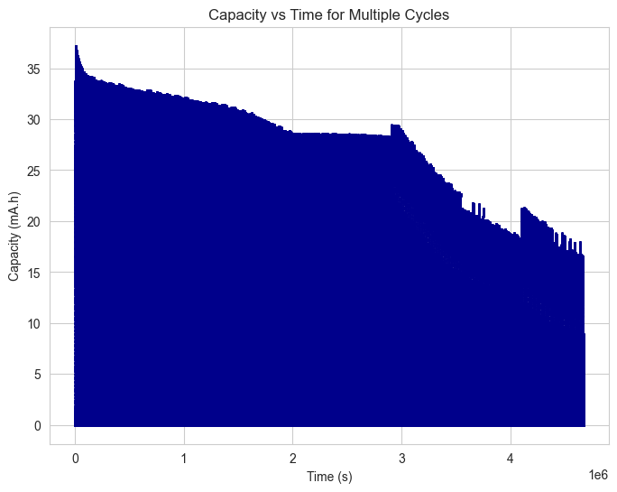
Data Exploration
Capacity data
Cycle 1 Cycle 1-350

Slide 15
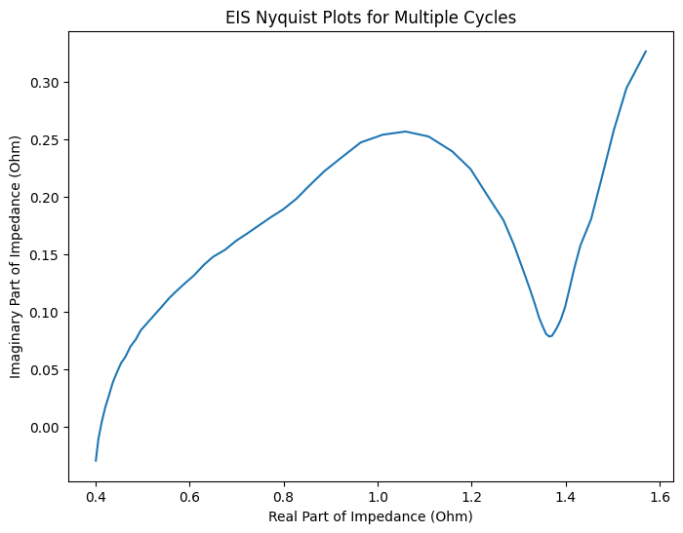
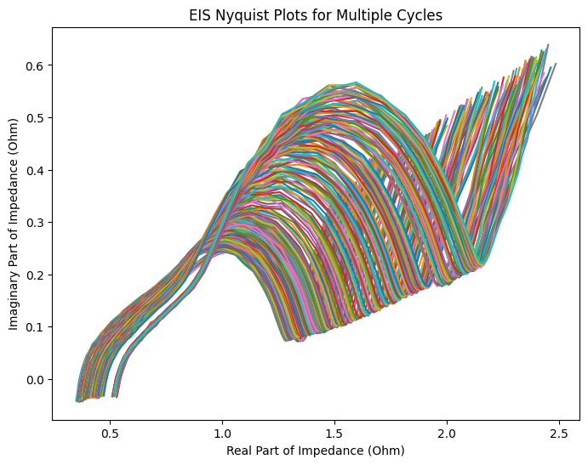
Data Exploration
EIS data
Cycle 1 Cycle 1-350

Slide 16
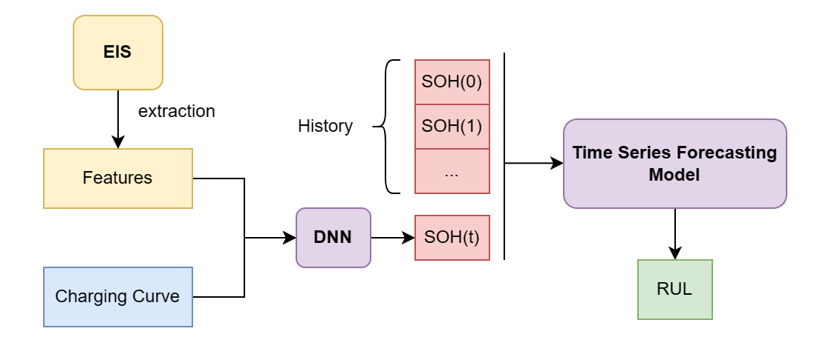
Objectives

Slide 17
Expected key results（milestones）
Milestones
The correlation between EIS features and SOH
Model 1: DNN model for SOH prediction
Model 2: Time Series Forecasting Model for Regression of SOH(t)

Slide 18
Reference
1．Wang, S., Jin, S., Bai, D., Fan, Y., Shi, H., & Fernandez, C. (2021). A critical review of improved deep learning methods for the remaining useful life prediction of lithium-ion batteries. Energy Reports, 7, 5562–5574. https://doi.org/10.1016/j.egyr.2021.08.182
2．Ansari, S., Ayob, A., Hossain Lipu, M. S., Hussain, A., & Saad, M. H. M. (2022). Remaining useful life prediction for lithium-ion battery storage system: A comprehensive review of methods, key factors, issues and future outlook. Energy Reports, 8, 12153–12185. https://doi.org/10.1016/j.egyr.2022.09.043
3．Wang, S., Jin, S., Deng, D., & Fernandez, C. (2021). A Critical Review of Online Battery Remaining Useful Lifetime Prediction Methods. Frontiers in Mechanical Engineering, 7. https://doi.org/10.3389/fmech.2021.719718
4．Park, K., Choi, Y., Choi, W. J., Ryu, H.-Y., & Kim, H. (2020). LSTM-Based Battery Remaining Useful Life Prediction With Multi-Channel Charging Profiles. IEEE Access, 8, 20786–20798. https://doi.org/10.1109/access.2020.2968939
5．Xu, Q., Wu, M., Khoo, E., Chen, Z., & Li, X. (2023). A Hybrid Ensemble Deep Learning Approach for Early Prediction of Battery Remaining Useful Life. IEEE/CAA Journal of Automatica Sinica, 10(1), 177–187.
https://doi.org/10.1109/jas.2023.123024
6．Lu, J., Xiong, R., Tian, J., Wang, C., & Sun, F. (2023). Deep learning to estimate lithium-ion battery state of health without additional degradation experiments. Nature Communications, 14(1). https://doi.org/10.1038/s41467-023-38458-w
7．Zhang, Y., Tang, Q., Zhang, Y., Wang, J., Stimming, U., & Lee, A. A. (2020). Identifying degradation patterns of lithium ion batteries from impedance spectroscopy using machine learning. Nature Communications, 11(1). https://doi.org/10.1038/s41467-020-15235-7

Slide 19
Q&A
答辩人：王浩羽
时间:2023年11月25日
指导：博士生张家祺
博士生许家豪

Slide 20
Objectives
feature extraction
correlation
EIS
Pivotal Features
SOH
Charging curve
EIS features
SOH
Model 1: DNN

Slide 21
Objectives
SOH(0)
SOH(t1)
SOH(t2)
.
.
.
SOH(now)
Model 1
BMS
SOH series
Period Measurement
Model 2: Time Series Forecasting Model
SOH = SOH(t), t is time or cycle
Given failure threshold, such as 80%
Current RUL

